Slide 1
APS 145 W01 PRESENTATION
-HARSHIL PRAJAPATI
APS 145 ZCC

Slide 2
BASKETBALL SHOOTOUT

Slide 3
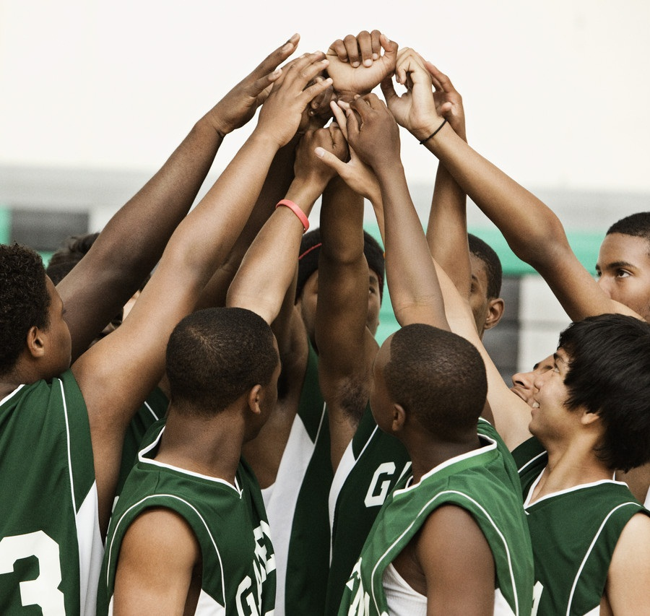
Two Student challenge for a basketball competition
NOTE:
To change images on this slide, select a picture and delete it. Then click the Insert Picture icon
in the placeholder to insert your own image.

Slide 4
Rolling Dice
Student with the lowest number goes first
If the game tie they have to roll dice again until the winner declares

Slide 5
Game rules
Each player get 3 attempts
Attempts | Student 1 | Student 2
1 | 🏀 | 🏀
2 | 🏀 | 🏀
3 | 🏀 | 🏀

Slide 6
winner
Student with more successful basket declared as a winner
If it’s tie then the game will repeat until the winner declares

Slide 7
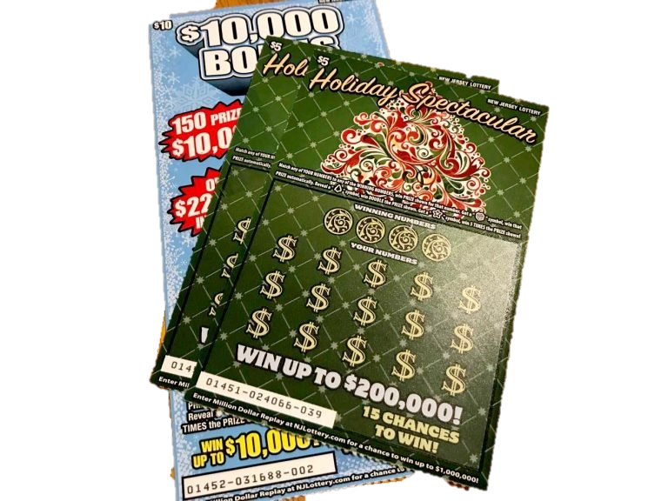
Reward..
Looser have to give lottery ticket(s) to the winner
This Photo by Unknown Author is licensed under CC BY-SA-NC

Slide 8
How many lottery tickets
Number of successful basket by winner less the successful basket by looser
For each tie game the numers of lottery tickets is reduced by 0.5
Lottery tickets can not be sold as a half so the decimal value is rounded up to the nearest whole number

Slide 9

YEAHHHHH…. WE FINALLY GET THE WINNER…..!!
This Photo by Unknown Author is licensed under CC BY
This Photo by Unknown Author is licensed under CC BY

Slide 10
Thankyou..

